Slide 1
UNIT-II
Processes , Threads and Process Scheduling
Processes :
      Process Concept,
      Process scheduling,
      Operations on processes,
      Inter-process communication.
Department of CSE, Aditya College of Engineering & Technology, Surampalem

Slide 2
1 Process Concept :
Process is a program in execution.
Examples of "processes" include:
  opening a web browser,
  playing a music file,
  running a word processor document,
  compiling code,
  sending an email,
  downloading a file, or
  even just the background processes that keep your computer running smoothly
Process and job can be used interchangeably.
Department of CSE, Aditya College of Engineering & Technology, Surampalem

Slide 3

1.1 The Process
The status of the current activity of a process is represented by the value of the program counter and the contents of the processor’s registers.
The memory layout of a process is typically divided into multiple sections:
  Text section— the executable code
  Data section—global variables
  Heap section—memory that is dynamically allocated during program run time
  Stack section— temporary data storage when invoking functions (such as function parameters, return addresses, and local variables)
Department of CSE, Aditya College of Engineering & Technology, Surampalem

Slide 4
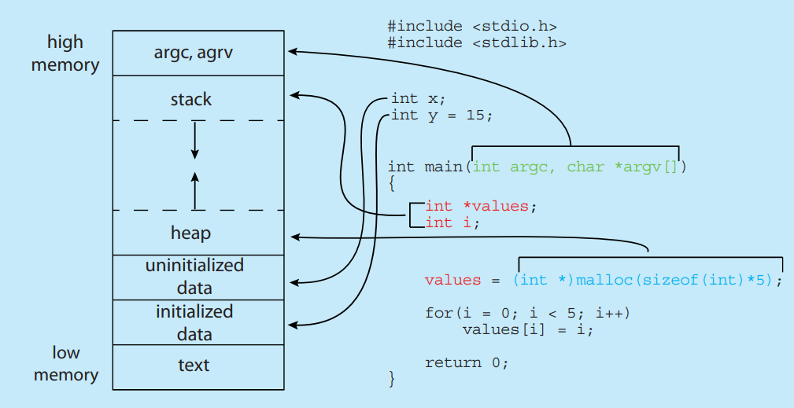
Department of CSE, Aditya College of Engineering & Technology, Surampalem

Slide 5
1.2 Process States :
As a process executes, it changes state. The state of a process is defined in part by the current activity of that process. A process may be in one of the following states:
  new: The process is being created
  running: Instructions are being executed
  waiting: The process is waiting for some event to occur
  ready: The process is waiting to be assigned to a processor
  terminated: The process has finished execution
Only one process can be running on any processor core at any instant. Many processes may be ready and waiting.
Department of CSE, Aditya College of Engineering & Technology, Surampalem

Slide 6

Process State Diagram
Department of CSE, Aditya College of Engineering & Technology, Surampalem

Slide 7
1.3 Process Control Block
Each process is represented in the operating system by a process control block (PCB)—also called a task control block.
It contains many pieces of information associated with a specific process, including these:
  Process state :The state may be new, ready, running, waiting, halted, and so on.
  Program counter : The counter indicates the address of the next instruction to be executed for this process
  CPU registers : The registers vary in number and type, depending on the computer architecture. They include accumulators, index registers, stack pointers, and general-purpose registers, plus any condition-code information
Department of CSE, Aditya College of Engineering & Technology, Surampalem

Slide 8
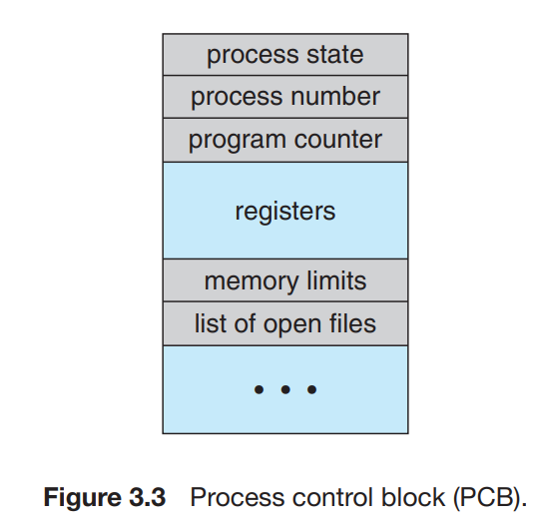
CPU-scheduling information : This information includes a process priority, pointers to scheduling queues, and any other scheduling parameters
Memory-management information : This information may include such items as the value of the base and limit registers and the page tables, or the segment tables, depending on the memory system used by the operating system
Accounting information : This information includes the amount of CPU and real time used, time limits, account numbers, job or process numbers, and so on.
I/O status information : This information includes the list of I/O devices allocated to the process, a list of open files, and so on
Department of CSE, Aditya College of Engineering & Technology, Surampalem

Slide 9
2. Process Scheduling
In general, most processes can be described as either -
  I/O bound : An I/O-bound process is one that spends more of its time doing I/O than it spends doing computations
  CPU bound : A CPU-bound process, in contrast, generates I/O requests infrequently, using more of its time doing computations.
The number of processes currently in memory is known as the degree of multiprogramming
The objective of multiprogramming is to have some process running at all times so as to maximize CPU utilization.
The objective of time sharing is to switch a CPU core among processes so frequently that users can interact with each program while it is running.
To meet these objectives, the process scheduler selects an available process (possibly from a set of several available processes) for program execution on a core.
Department of CSE, Aditya College of Engineering & Technology, Surampalem

Slide 10
2.1 Scheduling Queues
The various scheduling queues of processes are :
  Job queue – set of all processes in the system
  Ready queue – set of all processes residing in main memory, ready and waiting to execute
  Wait queue - Processes that are waiting for a certain event to occur — such as completion of I/O
Processes migrate among the various queues
These queues are generally stored as a linked list;
  a queue header contains pointers to the first PCB in the list, and each PCB includes a pointer field that points to the next PCB in the queue
Department of CSE, Aditya College of Engineering & Technology, Surampalem

Slide 11
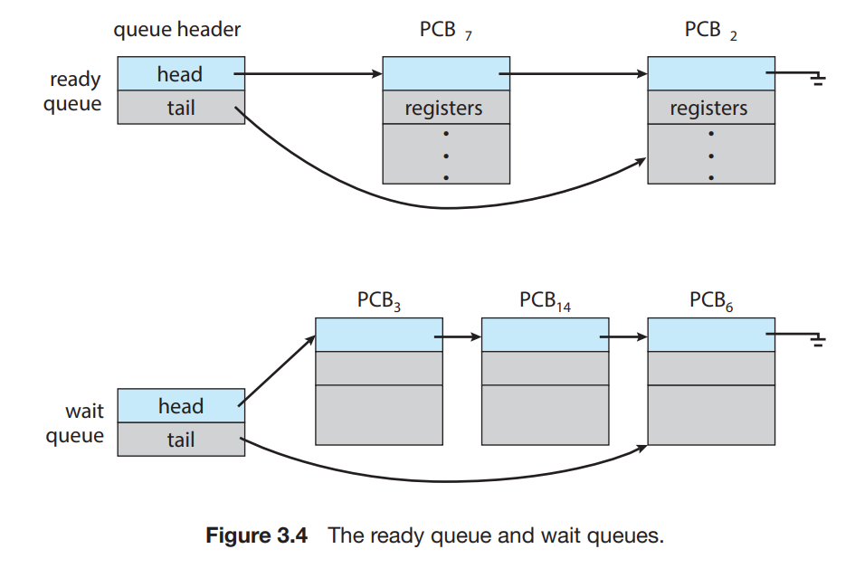
Department of CSE, Aditya College of Engineering & Technology, Surampalem

Slide 12
Queueing Diagram
A common representation of process scheduling is a queueing diagram.
Two types of queues are present:
  the ready queue and
  a set of wait queues.
The circles represent the resources that serve the queues, and the arrows indicate the flow of processes in the system.
A new process is initially put in the ready queue. It waits there until it is selected for execution, or dispatched.
Department of CSE, Aditya College of Engineering & Technology, Surampalem

Slide 13
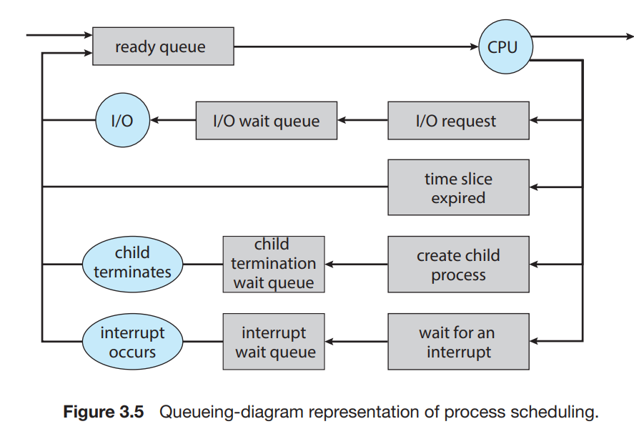

Department of CSE, Aditya College of Engineering & Technology, Surampalem

Slide 14
Once the process is allocated a CPU core and is executing, one of several events could occur:
  The process could issue an I/O request and then be placed in an I/O wait queue.
  The process could create a new child process and then be placed in a wait queue while it awaits the child’s termination.
  The process could be removed forcibly from the core, as a result of an interrupt or having its time slice expire, and be put back in the ready queue.
A process continues this cycle until it terminates, at which time it is removed from all queues and has its PCB and resources deallocated.
Department of CSE, Aditya College of Engineering & Technology, Surampalem

Slide 15
2.2 CPU Scheduling
The role of the CPU scheduler is to select from among the processes that are in the ready queue and allocate a CPU core to one of them.
The CPU scheduler must select a new process for the CPU frequently
A process can be “swapped out” from memory to disk, where its current status is saved, and later “swapped in” from disk back to memory, where its status is restored.This is called swapping .
  This is used to reduce degree of multiprogramming.
Department of CSE, Aditya College of Engineering & Technology, Surampalem

Slide 16
2.3 Context Switch
When an interrupt occurs, the system needs to save the current context of the process running on the CPU core so that it can restore that context when its processing is done, essentially suspending the process and then resuming it.
  The context includes the value of the CPU registers, the process state , and memory-management information(which is represented in the PCB of the process)
We perform a state save of the current state of the CPU core, be it in kernel or user mode, and then a state restore to resume operations.
Switching the CPU core to another process requires performing a state save of the current process and a state restore of a different process. This task is known as a context switch.
Department of CSE, Aditya College of Engineering & Technology, Surampalem

Slide 17
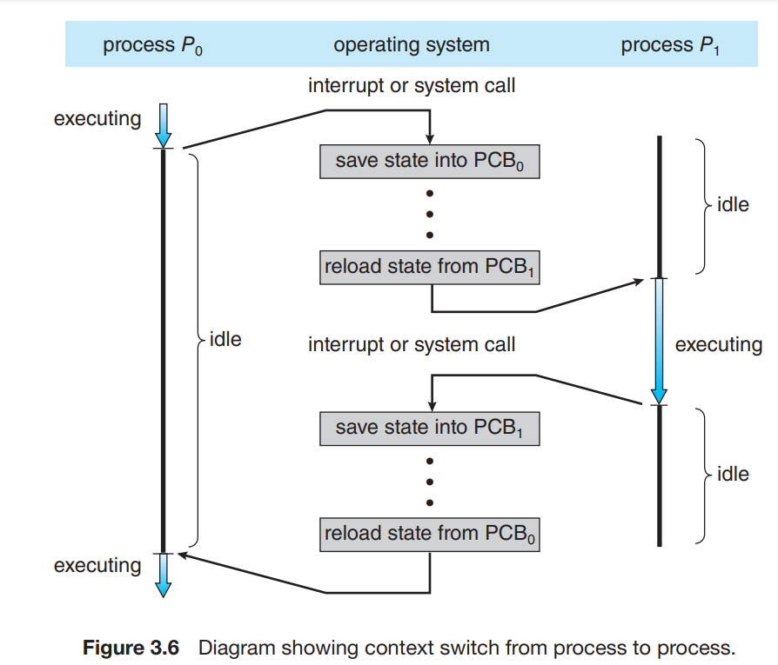
Department of CSE, Aditya College of Engineering & Technology, Surampalem

Slide 18
When a context switch occurs, the kernel saves the context of the old process in its PCB and loads the saved context of the new process scheduled to run.
Context switch time is pure overhead, because the system does no useful work while switching
Department of CSE, Aditya College of Engineering & Technology, Surampalem

Slide 19
3. Operations on Processes
The processes in most systems can execute concurrently, and they may be created and deleted dynamically. Thus, these systems must provide a mechanism for
  Process creation, and
  Process termination
Department of CSE, Aditya College of Engineering & Technology, Surampalem

Slide 20
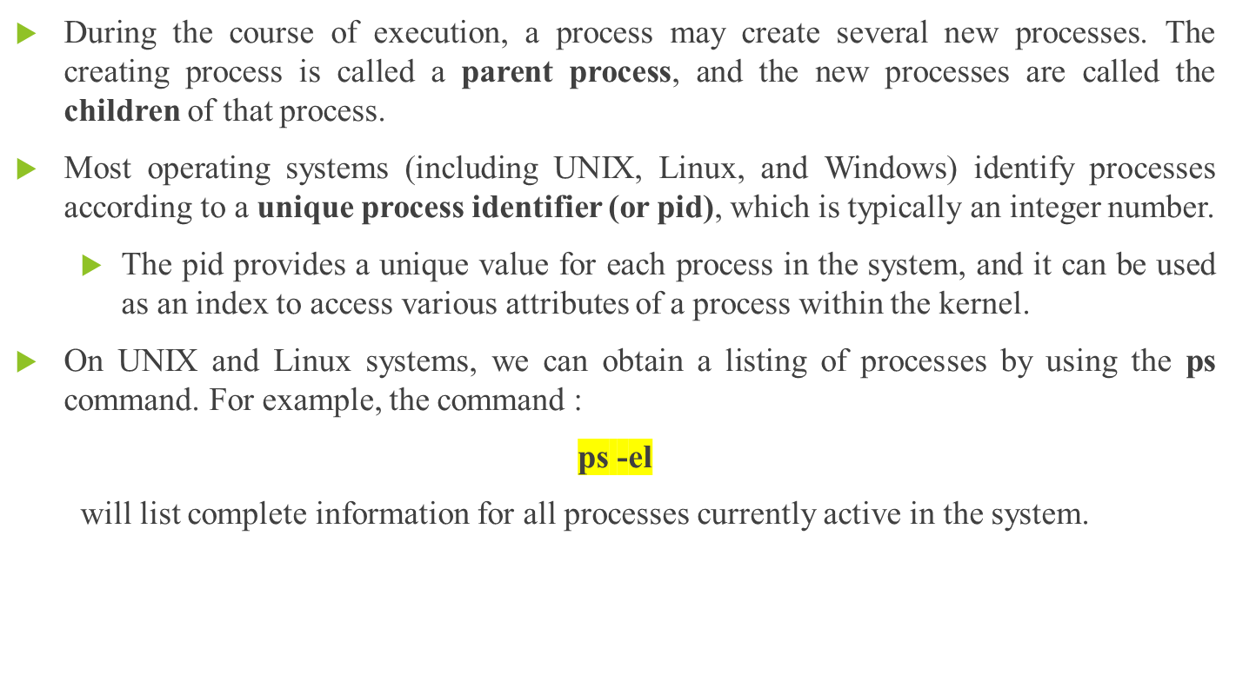
3.1 Process Creation
Department of CSE, Aditya College of Engineering & Technology, Surampalem

Slide 21
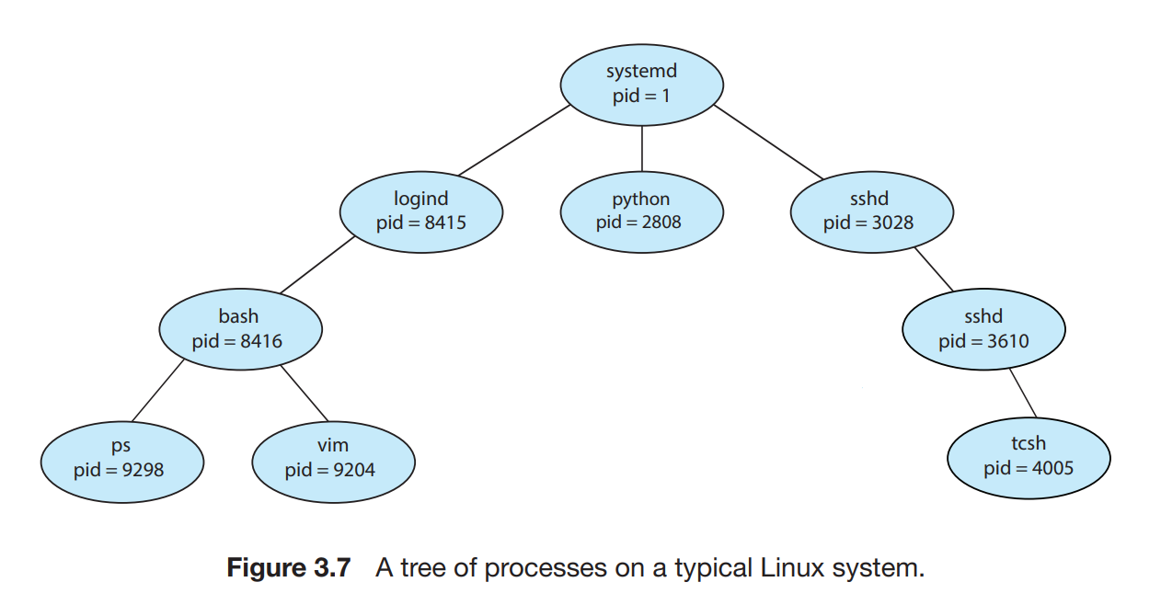
Department of CSE, Aditya College of Engineering & Technology, Surampalem

Slide 22
The systemd process (which always has a pid of 1) serves as the root parent process for all user processes
  It is the first user process created when the system boots.
Two children of systemd — logind and sshd.
  The logind process is responsible for managing clients that directly log onto the system.
  a client has logged on and is using the bash shell, which has been assigned pid 8416.
  Using the bash command-line interface, this user has created the process ps as well as the vim editor.
Department of CSE, Aditya College of Engineering & Technology, Surampalem

Slide 23
When a process creates a child process, that child process will need certain resources (CPU time, memory, files, I/O devices) to accomplish its task.
A child process may be able to obtain its resources directly from the operating system, or it may be constrained to a subset of the resources of the parent process.
The parent may have to partition its resources among its children, or it may be able to share some resources (such as memory or files) among several of its children.
Restricting a child process to a subset of the parent’s resources prevents any process from overloading the system by creating too many child processes
Department of CSE, Aditya College of Engineering & Technology, Surampalem

Slide 24
When a process creates a new process, two possibilities for execution exist:
  1. The parent continues to execute concurrently with its children.
  2. The parent waits until some or all of its children have terminated.
There are also two address-space possibilities for the new process:
  1. The child process is a duplicate of the parent process (it has the same program and data as the parent).
  2. The child process has a new program loaded into it.
System Calls used to create processes :
  fork() : Unix/Linux
  CreateProcess() :Windows
Department of CSE, Aditya College of Engineering & Technology, Surampalem

Slide 25
The fork system call is used for creating a new process in Linux, and Unix systems, which is called the child process, which runs concurrently with the process that makes the fork() call (parent process). Different values returned by fork():
  Negative Value: The creation of a child process was unsuccessful.
  Zero: Returned to the newly created child process.
  Positive value: Returned to parent or caller. The value contains the process ID of the newly created child process.
getpid() function returns the process ID of the calling process.
getppid() function returns the parent process ID of the calling process
Department of CSE, Aditya College of Engineering & Technology, Surampalem

Slide 26
wait(NULL) will block the parent process until any of its children has finished.
  If the child terminates before the parent process reaches wait(NULL) then the child process turns to a zombie process until its parent waits on it and its released from memory.
  If the parent process doesn't wait for its child, and the parent finishes first, then the child process becomes an orphan and is assigned to init as its child. And init will wait and release the process entry in the process table.
execlp() system call is used to replace the current process image with a new process image specified by a filename, essentially allowing you to run a new program within the current process.
Department of CSE, Aditya College of Engineering & Technology, Surampalem

Slide 27
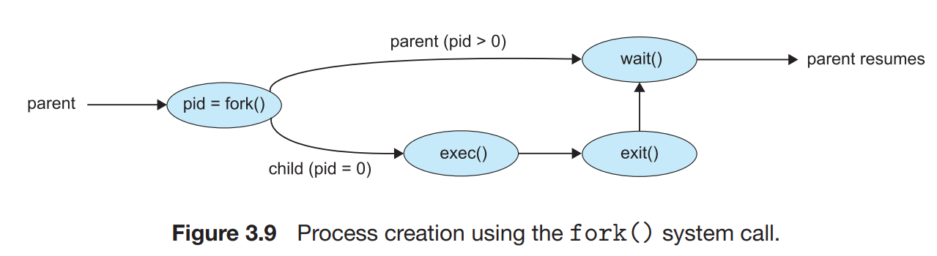
Department of CSE, Aditya College of Engineering & Technology, Surampalem

Slide 28
3.2 Process Termination
A process terminates when it finishes executing its final statement and asks the operating system to delete it
System Calls used to terminate processes :
  exit() : Unix/Linux
  TerminateProcess():Windows
Department of CSE, Aditya College of Engineering & Technology, Surampalem

Slide 29
A parent may terminate the execution of one of its children for a variety of reasons, such as these:
  The child has exceeded its usage of some of the resources that it has been allocated.
  The task assigned to the child is no longer required.
  The parent is exiting, and the operating system does not allow a child to continue if its parent terminates.
Some systems do not allow a child to exist if its parent has terminated. In such systems, if a process terminates (either normally or abnormally), then all its children must also be terminated. This phenomenon, referred to as cascading termination, is normally initiated by the operating system
Department of CSE, Aditya College of Engineering & Technology, Surampalem

Slide 30
4. Inter-process communication(IPC)
Processes executing concurrently in the operating system may be either
  independent process : A process is independent if it does not share data with any other processes executing in the system , or
  cooperating process : A process is cooperating if it can affect or be affected by the other processes executing in the system.
Reasons for providing an environment that allows process cooperation:
  Information sharing
  Computation speedup.
  Modularity
Department of CSE, Aditya College of Engineering & Technology, Surampalem

Slide 31
Cooperating processes require an interprocess communication (IPC) mechanism that will allow them to exchange data— that is, send data to and receive data from each other.
There are two fundamental models of interprocess communication:
  shared memory : a region of memory that is shared by the cooperating processes is established. Processes can then exchange information by reading and writing data to the shared region .
  message passing : communication takes place by means of messages exchanged between the cooperating processes.
Department of CSE, Aditya College of Engineering & Technology, Surampalem

Slide 32
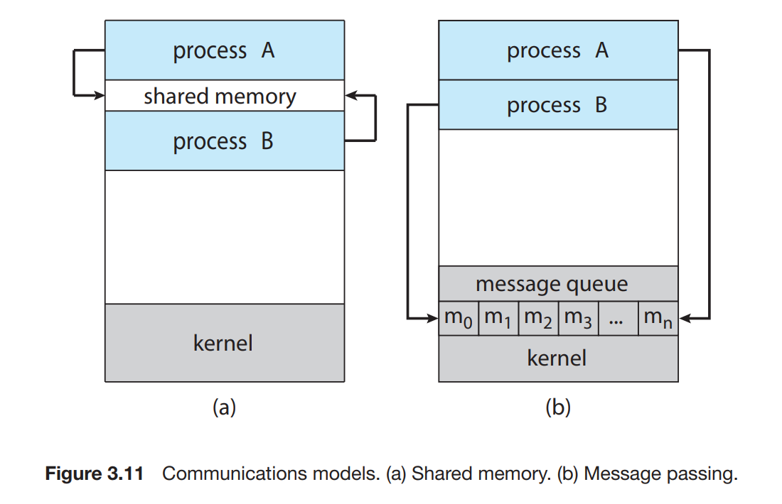
Department of CSE, Aditya College of Engineering & Technology, Surampalem

Slide 33
4.1 IPC in Shared-Memory Systems
A shared-memory region resides in the address space of the process creating the shared-memory segment.
  Other processes that wish to communicate using this shared-memory segment must attach it to their address space.
The processes are also responsible for ensuring that they are not writing to the same location simultaneously.
Producer– Consumer Problem : A producer process produces information that is consumed by a consumer process .
  Ex :- client–server paradigm : a server as a producer and a client as a consumer. a web server produces (that is, provides) web content such as HTML files and images, which are consumed (that is, read) by the client web browser requesting the resource.
Department of CSE, Aditya College of Engineering & Technology, Surampalem

Slide 34
One solution to the producer–consumer problem uses shared memory. To allow producer and consumer processes to run concurrently, we must have available a buffer of items that can be filled by the producer and emptied by the consumer
A producer can produce one item while the consumer is consuming another item. The producer and consumer must be synchronized, so that the consumer does not try to consume an item that has not yet been produced.
Two types of buffers can be used :
  The unbounded buffer places no practical limit on the size of the buffer. The consumer may have to wait for new items, but the producer can always produce new items.
  The bounded buffer assumes a fixed buffer size. In this case, the consumer must wait if the buffer is empty, and the producer must wait if the buffer is full.
Department of CSE, Aditya College of Engineering & Technology, Surampalem

Slide 35
4.2 IPC in Message-Passing System.
Message passing provides a mechanism to allow processes to communicate and to synchronize their actions without sharing the same address space.
It is particularly useful in a distributed environment, where the communicating processes may reside on different computers connected by a network.
A message-passing facility provides at least two operations:
  send(message)
  receive(message)
If processes P and Q want to communicate, they must send messages to and receive messages from each other: a communication link must exist between them.
Department of CSE, Aditya College of Engineering & Technology, Surampalem

Slide 36
Several methods for logically implementing a link and the send()/receive() operations:
      Direct or indirect communication
      Synchronous or asynchronous communication
      Automatic or explicit buffering
Department of CSE, Aditya College of Engineering & Technology, Surampalem

Slide 37
4.2.1 Naming
Processes that want to communicate must have a way to refer to each other. They can use either direct or indirect communication.
Under direct communication, each process that wants to communicate must explicitly name the recipient or sender of the communication.
In this scheme, the send() and receive() primitives are defined as:
symmetry in addressing
  send(P, message) — Send a message to process P.
  receive(Q, message)—Receive a message from process Q.
asymmetry in addressing
  send(P, message)—Send a message to process P.
  receive(id, message)—Receive a message from any process.
Department of CSE, Aditya College of Engineering & Technology, Surampalem

Slide 38
With indirect communication, the messages are sent to and received from mailboxes, or ports.
A mailbox can be viewed abstractly as an object into which messages can be placed by processes and from which messages can be removed.
A process can communicate with another process via a number of different mailboxes, but two processes can communicate only if they have a shared mailbox.
The send() and receive() primitives are defined as follows:
  send(A, message)—Send a message to mailbox A.
  receive(A, message)—Receive a message from mailbox A.
Department of CSE, Aditya College of Engineering & Technology, Surampalem

Slide 39
4.2.2 Synchronization
Message passing may be either blocking or nonblocking— also known as synchronous and asynchronous.
  Blocking send. The sending process is blocked until the message is received by the receiving process or by the mailbox.
  Nonblocking send. The sending process sends the message and resumes operation.
  Blocking receive. The receiver blocks until a message is available.
  Nonblocking receive. The receiver retrieves either a valid message or a null.
Department of CSE, Aditya College of Engineering & Technology, Surampalem

Slide 40
4.2.3 Buffering
Whether communication is direct or indirect, messages exchanged by communicating processes reside in a temporary queue.
Basically, such queues can be implemented in three ways:
  Zero capacity: The queue has a maximum length of zero; thus, the link cannot have any messages waiting in it. In this case, the sender must block until the recipient receives the message.
  Bounded capacity : The queue has finite length n; thus, at most n messages can reside in it. If the queue is not full when a new message is sent, the message is placed in the queue and the sender can continue execution without waiting. If the link is full, the sender must block until space is available in the queue
  Unbounded capacity : The queue’s length is potentially infinite; thus, any number of messages can wait in it. The sender never blocks.
Department of CSE, Aditya College of Engineering & Technology, Surampalem

Slide 41
CPU Scheduling :
      Basic Concepts,
      Scheduling criteria,
      Scheduling algorithms,
      Multiple Processor scheduling.
Department of CSE, Aditya College of Engineering & Technology, Surampalem

Slide 42
1 Basic Concepts
The objective of multiprogramming is to have some process running at all times, to maximize CPU utilization
When one process has to wait for an I/O or an event, the operating system takes the CPU away from that process and gives the CPU to another process.
Every time one process has to wait, another process can take over use of the CPU
Department of CSE, Aditya College of Engineering & Technology, Surampalem

Slide 43
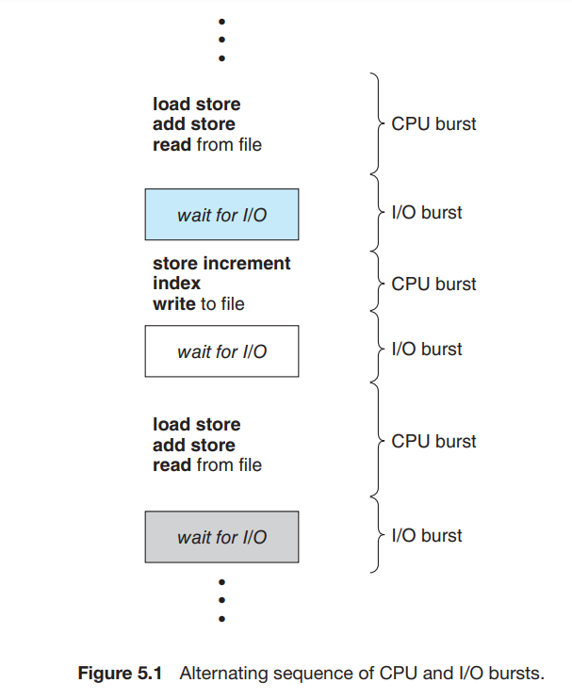
1.1 CPU – I/O Burst Cycle
Department of CSE, Aditya College of Engineering & Technology, Surampalem

Slide 44
The success of CPU scheduling depends on an observed property of processes: process execution consists of a cycle of CPU execution and I/O wait.
Processes alternate between these two states.
Process execution begins with a CPU burst. That is followed by an I/O burst, which is followed by another CPU burst, then anotherI/O burst, and so on.
Eventually, the final CPU burst ends with a system request to terminate execution
Department of CSE, Aditya College of Engineering & Technology, Surampalem

Slide 45
1.2 CPU Scheduler
Whenever the CPU becomes idle, the operating system must select one of the processes in the ready queue to be executed.
The selection process is carried out by the CPU scheduler, which selects a process from the processes in memory that are ready to execute and allocates the CPU to that process.
There are three types of process schedulers:
  Long term Scheduler or Job Scheduler
  Short term Scheduler or CPU Scheduler.
  Medium term Scheduler
Department of CSE, Aditya College of Engineering & Technology, Surampalem

Slide 46
Long term Scheduler or Job Scheduler
  Long Term Scheduler loads a process from disk to main memory for execution. i.e., a new process to the ‘Ready State’.
  It mainly moves processes from Job Queue to Ready Queue.
  It controls the Degree of Multi-programming, i.e., the number of processes present in a ready state or in main memory at any point in time.
Short term Scheduler or CPU Scheduler :
  CPU Scheduler is responsible for selecting one process from the ready state for running state (or assigning CPU to it).
  It mainly calls dispatcher.
  Fastest among the three (that is why called Short Term).
Department of CSE, Aditya College of Engineering & Technology, Surampalem

Slide 47
Medium Term Scheduler :
  Medium Term Scheduler (MTS) is responsible for moving a process from memory to disk (or swapping).
  Running processes may become suspended if it makes an I/O request.
  A suspended processes cannot make any progress towards completion. In this condition, to remove the process from memory and make space for other processes, the suspended process is moved to the secondary storage. This process is called swapping, and the process is said to be swapped out or rolled out. Swapping may be necessary to improve the process mix (of CPU bound and I/O bound)
Department of CSE, Aditya College of Engineering & Technology, Surampalem

Slide 48
1.3 Preemptive and Non Preemptive Scheduling
Preemptive Scheduling :The operating system can interrupt or preempt a running process to allocate CPU time to another process, typically based on priority or time-sharing policies. Mainly a process is switched from the running state to the ready state.
  EX : Round Robin (RR) , Shortest Remaining Time First (SRTF) , Priority (preemptive version)
Non-preemptive scheduling : A running process cannot be interrupted by the operating system; it voluntarily relinquishes control of the CPU.
  In this scheduling, once the resources (CPU cycles) are allocated to a process, the process holds the CPU till it gets terminated or reaches a waiting state
  First Come First Serve, Shortest Job First (SJF basically non preemptive) and Priority (non preemptive version)
Department of CSE, Aditya College of Engineering & Technology, Surampalem

Slide 49
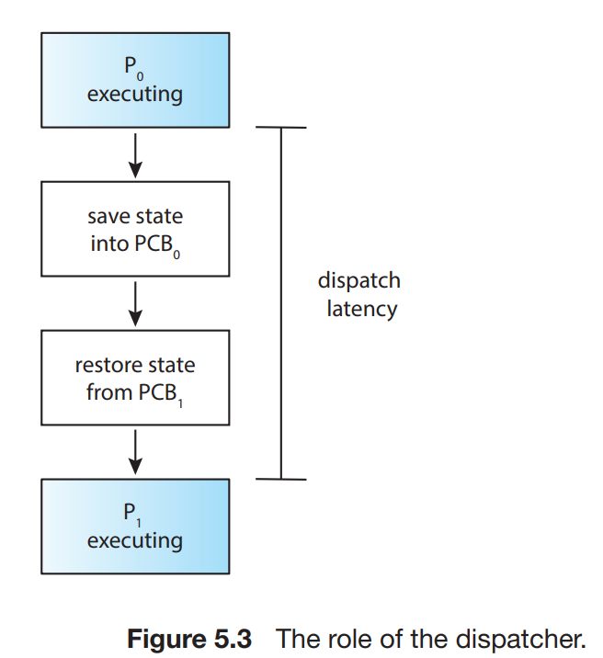
1.4 Dispatcher
The dispatcher is the module that gives control of the CPU’s core to the process selected by the CPU scheduler.
This function involves the following:
  • Switching context from one process to another
  • Switching to user mode
  • Jumping to the proper location in the user program to resume that program
The time it takes for the dispatcher to stop one process and start another running is known as the dispatch latency
Department of CSE, Aditya College of Engineering & Technology, Surampalem

Slide 50
2 Scheduling Criteria
The scheduling criteria include the following:
CPU utilization : We want to keep the CPU as busy as possible. Conceptually, CPU utilization can range from 0 to 100 percent.
  In a real system, it should range from 40 percent (for a lightly loaded system) to 90 percent (for a heavily loaded system).
Throughput : Number of processes that are completed per time unit, called throughput.
  For long processes, this rate may be one process over several seconds; for short transactions, it may be tens of processes per second.
Department of CSE, Aditya College of Engineering & Technology, Surampalem

Slide 51
Waiting time : Waiting time is the sum of the periods spent waiting in the ready queue
Response time : Time from the submission of a request until the first response is produced is called response time .
Turnaround time : The interval from the time of submission of a process to the time of completion is the turnaround time. Turnaround time is the sum of the periods spent waiting in the ready queue, executing on the CPU, and doing I/O.
Department of CSE, Aditya College of Engineering & Technology, Surampalem

Slide 52
3 . Scheduling criteria
Department of CSE, Aditya College of Engineering & Technology, Surampalem

Slide 53
3.1 FCFS
First Come, First Serve (FCFS) is one of the simplest types of CPU scheduling algorithms.
The process that requests the CPU first is allocated the CPU first. The implementation of the FCFS policy is easily managed with a FIFO queue.
FCFS Scheduling is a non-preemptive algorithm, meaning once a process starts running, it cannot be stopped until it voluntarily relinquishes the CPU, typically when it terminates or performs I/O.
This method treats all processes equally, without priority distinctions.
CONVOY EFFECT :
  As it is a Non-preemptive CPU Scheduling Algorithm, FCFS can result in long waiting times, especially if a long process arrives before a shorter one. This is known as the convoy effect, where shorter processes are forced to wait behind longer processes, leading to inefficient execution.
Department of CSE, Aditya College of Engineering & Technology, Surampalem

Slide 54
Problem 1: Consider the following set of processes that arrive at time 0, with the length of the CPU burst given in milliseconds:
Process Burst Time
    P1 24
    P2 3
    P3 3
Department of CSE, Aditya College of Engineering & Technology, Surampalem

Slide 55
3.2 Shortest-Job-First Scheduling(SJF)
This algorithm associates with each process the length of the process’s next CPU burst time.
When the CPU is available, it is assigned to the process that has the smallest next CPU burst.
  If the next CPU bursts of two processes are the same, FCFS scheduling is used to break the tie.
This scheduling method can be
  Non preemptive :SJF
  Preemptive : SRTF (Shortest Remaining Time First/Next)
Department of CSE, Aditya College of Engineering & Technology, Surampalem

Slide 56
Non preemptive SJF
  The shortest job first (SJF) or shortest job next, is a scheduling policy that selects the waiting process with the smallest execution time to execute next. SJF is also known as Shortest Job Next (SJN).
  Shortest Job first has the advantage of having a minimum average waiting time among all scheduling algorithms.
Preemptive SJF ➔ SRTF (Shortest Remaining Time First)
  Preemptive version of Shortest Job First (SJF) scheduling is called Shortest Remaining Time First (SRTF).
  In SRTF, the process with the least time left to finish is selected to run. The running process will continue until it finishes or a new process with a shorter remaining time arrives. This way, the process that can finish the fastest is always given priority.
Department of CSE, Aditya College of Engineering & Technology, Surampalem

Slide 57
3.3 Round Robin Scheduling Algorithm
The round-robin (RR) scheduling algorithm is similar to FCFS scheduling, but preemption is added to enable the system to switch between processes.
A small unit of time, called a time quantum or time slice, is defined.
  A time quantum is generally from 10 to 100 milliseconds in length.
  The ready queue is treated as a circular queue.
  The CPU scheduler goes around the ready queue, allocating the CPU to each process for a time slice.
It is called "round robin" because the system rotates through all the processes, allocating each of them a fixed time slice or "quantum", regardless of their priority.
Department of CSE, Aditya College of Engineering & Technology, Surampalem

Slide 58
3.4 Priority Scheduling Algorithm
Priority scheduling is one of the most common scheduling algorithms used by the operating system to schedule processes based on their priority.
Each process is assigned a priority. The process with the highest priority is to be executed first and so on.
  Processes with the same priority are executed on a first-come first served basis.
Priority Scheduling can be implemented in two ways:
  Non-Preemptive Priority Scheduling
  Preemptive Priority Scheduling
Department of CSE, Aditya College of Engineering & Technology, Surampalem

Slide 59
Non-Preemptive Priority Scheduling
  In Non-Preemptive Priority Scheduling, the CPU is not taken away from the running process. Even if a higher-priority process arrives, the currently running process will complete first.
  Ex: A high-priority process must wait until the currently running process finishes.
Preemptive Priority Scheduling :
  In Preemptive Priority Scheduling, the CPU can be taken away from the currently running process if a new process with a higher priority arrives.
  Ex: A low-priority process is running, and a high-priority process arrives; the CPU immediately switches to the high-priority process.
Department of CSE, Aditya College of Engineering & Technology, Surampalem

Slide 60
STARVATION :
  A major problem with priority scheduling algorithms is indefinite blocking, or starvation.
  A process that is ready to run but waiting for the CPU can be considered blocked.
  A priority scheduling algorithm can leave some low priority processes waiting indefinitely.
  In a heavily loaded computer system, a steady stream of higher-priority processes can prevent a low-priority process from ever getting the CPU
AGING :
  A solution to the problem of indefinite blockage of low-priority processes is aging. Aging involves gradually increasing the priority of processes that wait in the system for a long time
Department of CSE, Aditya College of Engineering & Technology, Surampalem

